Slide 1
COURSE TITLE: Operating Systems
UNIT - 5

Slide 2
UNIT 5: I/O Management

Slide 3
RAID
RAID is a technique that makes use of a combination of multiple disks instead of using a single disk for increased performance, data redundancy, or both.
RAID or redundant array of independent disks is a data storage virtualization technology that combines multiple physical disk drive components into one or more logical units for data redundancy, performance improvement, or both.
It is a way of storing the same data in different places on multiple hard disks or solid-state drives to protect data in the case of a drive failure. A RAID system consists of two or more drives working in parallel. These can be hard discs, but there is a trend to use SSD technology (Solid State Drives).

Slide 4
RAID
RAID combines several independent and relatively small disks into single storage of a large size. The disks included in the array are called array members. The disks can combine into the array in different ways, which are known as RAID levels.
Key Evaluation Points for a RAID System
Reliability: How many disk faults can the system tolerate?
Availability: What fraction of the total session time is a system in uptime mode, i.e. how available is the system for actual use?
Performance: How good is the response time? How high is the throughput (rate of processing work)? Note that performance contains a lot of parameters and not just the two.
Capacity: Given a set of N disks each with B blocks, how much useful capacity is available to the user?

Slide 5
RAID
Standards RAID Levels
Below are the following most popular and standard RAID levels.
1. RAID 0 (striped disks)
RAID 0 is taking any number of disks and merging them into one large volume. It will increase speeds as you're reading and writing from multiple disks at a time. But all data on all disks is lost if any one disk fails. An individual file can then use the speed and capacity of all the drives of the array. The downside to RAID 0, though, is that it is NOT redundant. The loss of any individual disk will cause complete data loss. This RAID type is very much less reliable than having a single disk.

Slide 6
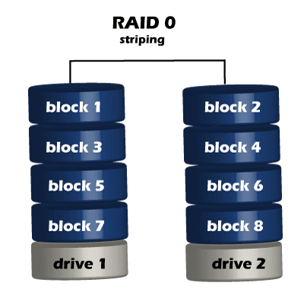
RAID
1. RAID 0 (striped disks)

Slide 7
RAID
RAID 0 (striped disks)
RAID 0 (Striping): Imagine you have two disks, and you split your data into small pieces, like pages of a book. You write these pages on both disks at the same time. This makes reading and writing faster because you have two "hands" working together. But if one disk breaks, you lose the whole book because each page relies on the other.

Slide 8
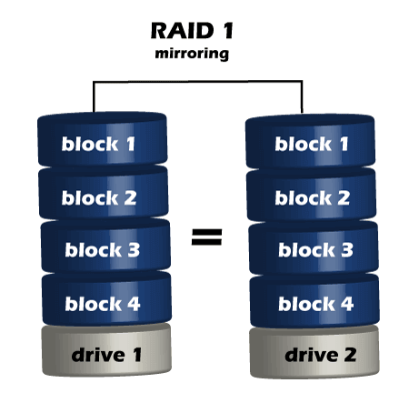
RAID
2. RAID 1 (Mirroring):
Think of RAID 1 like making a photocopy of your book. You have two identical copies. If one book gets damaged, you still have the other one. It's a safe way to store your data, but you're not using the two books to make things faster.

Slide 9
RAID
3. RAID 5 (Striping with Parity):
This is like having multiple people working on different parts of the same puzzle. They all have their pieces, and if one person leaves, you can still finish the puzzle because you know what the missing piece should look like. RAID 5 uses "parity" information to recover data if one disk breaks.
RAID 5 requires the use of at least three drives. It combines these disks to protect data against loss of any one disk; the array's storage capacity is reduced by one disk. It strips data across multiple drives to increase performance. But, it also adds the aspect of redundancy by distributing parity information across the disks.

Slide 10
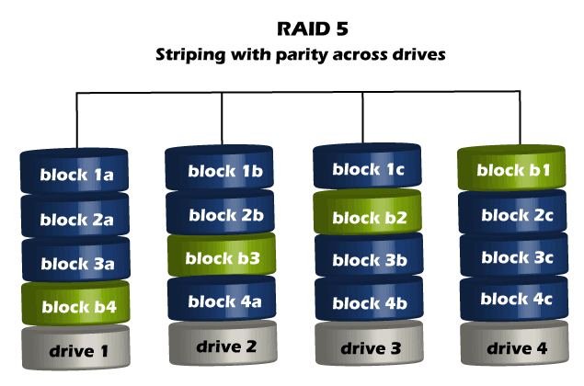
RAID
3. RAID 5 (Striping with Parity):

Slide 11
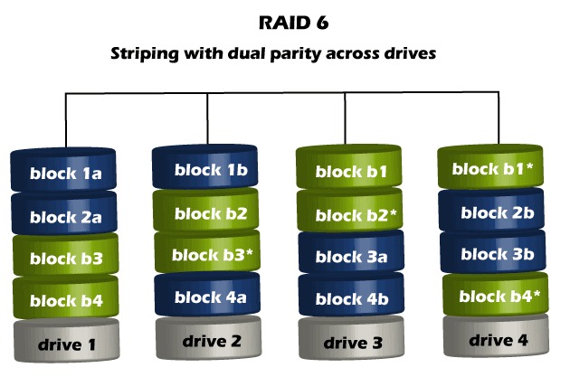
RAID
4. RAID 6 (Striping with Double Parity):
This is like RAID 5 but with an extra safety net. Instead of just one person holding the missing puzzle piece, now you have two people holding backup pieces. Even if two people leave, you can still finish the puzzle.

Slide 12
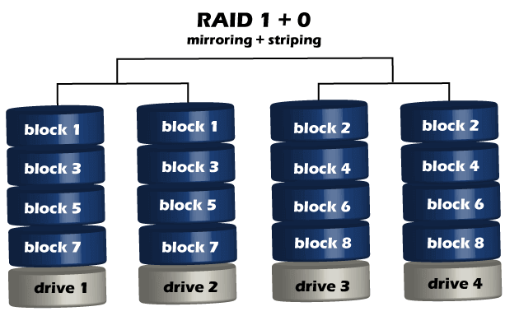
RAID
5. RAID 10 (Combining RAID 1 and RAID 0):
You can think of RAID 10 as both mirroring and striping. You make copies of your book and split them between two pairs of hands, so you get both speed and safety. If one book or one person has a problem, you still have the other book and the other person working.

Slide 13
Disk Scheduling Algorithms
Disk scheduling is done by operating systems to schedule I/O requests arriving for the disk. Disk scheduling is also known as I/O Scheduling.
Key Terms Associated with Disk Scheduling
1. Seek Time: Seek time is the time taken to locate the disk arm to a specified track where the data is to be read or written. So the disk scheduling algorithm that gives a minimum average seek time is better.

Slide 14
Disk Scheduling Algorithms
2. Rotational Latency: Rotational Latency is the time taken by the desired sector of the disk to rotate into a position so that it can access the read/write heads. So the disk scheduling algorithm that gives minimum rotational latency is better.
3. Transfer Time: Transfer time is the time to transfer the data. It depends on the rotating speed of the disk and the number of bytes to be transferred.
4. Disk Access Time:
Disk Access Time = Seek Time + Rotational Latency + Transfer Time
Total Seek Time = Total head Movement * Seek Time

Slide 15
Disk Scheduling Algorithms
Disk Scheduling Algorithms
There are several Disk Several Algorithms. We will discuss each one of them.
FCFS (First Come First Serve)
FCFS is the simplest of all Disk Scheduling Algorithms. In FCFS, the requests are addressed in the order they arrive in the disk queue. Let us understand this with the help of an example.

Slide 16
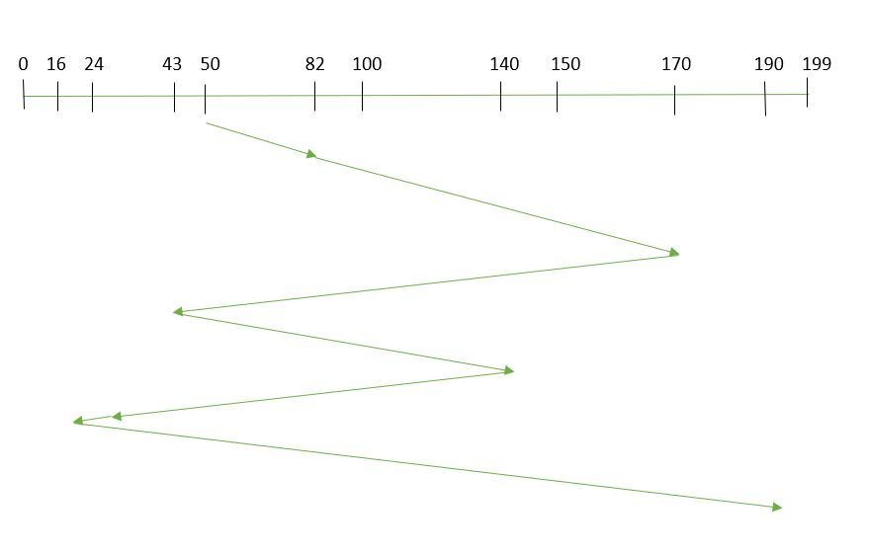
Disk Scheduling Algorithms
FCFS (First Come First Serve)
Suppose the order of request is- (82,170,43,140,24,16,190)
And current position of Read/Write head is: 50

Slide 17
Disk Scheduling Algorithms
Example:
Suppose the order of request is- (82,170,43,140,24,16,190)
And current position of Read/Write head is: 50
So, total overhead movement (total distance covered by the disk arm) =
(82-50)+(170-82)+(170-43)+(140-43)+(140-24)+(24-16)+(190-16) =642

Slide 18
Disk Scheduling Algorithms
Advantages of FCFS
Every request gets a fair chance
No indefinite postponement
Disadvantages of FCFS
Does not try to optimize seek time
May not provide the best possible service

Slide 19
Disk Scheduling Algorithms
SSTF (Shortest Seek Time First)
In SSTF (Shortest Seek Time First), requests having the shortest seek time are executed first.
So, the seek time of every request is calculated in advance in the queue and then they are scheduled according to their calculated seek time.
As a result, the request near the disk arm will get executed first. SSTF is certainly an improvement over FCFS as it decreases the average response time and increases the throughput of the system.

Slide 20
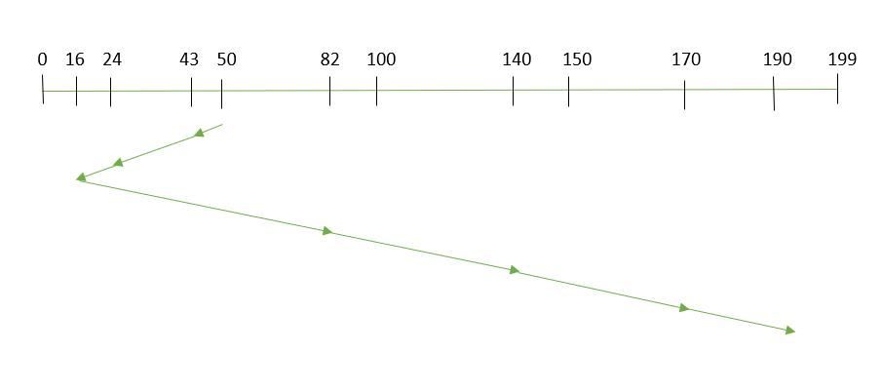
Disk Scheduling Algorithms
SSTF (Shortest Seek Time First)
Suppose the order of request is- (82,170,43,140,24,16,190)

Slide 21
Disk Scheduling Algorithms
SSTF (Shortest Seek Time First)
Suppose the order of request is- (82,170,43,140,24,16,190)
And current position of Read/Write head is: 50
So,
total overhead movement (total distance covered by the disk arm) =
(50-43)+(43-24)+(24-16)+(82-16)+(140-82)+(170-140)+(190-170) =208

Slide 22
Disk Scheduling Algorithms
Advantages of Shortest Seek Time First
The average Response Time decreases
Throughput increases
Disadvantages of Shortest Seek Time First
Overhead to calculate seek time in advance
Can cause Starvation for a request if it has a higher seek time as compared to incoming requests
The high variance of response time as SSTF favors only some requests

Slide 23
Disk Scheduling Algorithms
SCAN
In the SCAN algorithm the disk arm moves in a particular direction and services the requests coming in its path and after reaching the end of the disk, it reverses its direction and again services the request arriving in its path.
So, this algorithm works as an elevator and is hence also known as an elevator algorithm. As a result, the requests at the midrange are serviced more and those arriving behind the disk arm will have to wait.

Slide 24
Disk Scheduling Algorithms
SCAN
Suppose the requests to be addressed are-82,170,43,140,24,16,190. And the Read/Write arm is at 50, and it is also given that the disk arm should move “towards the larger value”.
Therefore, the total overhead movement (total distance covered by the disk arm) is calculated as
= (199-50) + (199-16) = 332

Slide 25
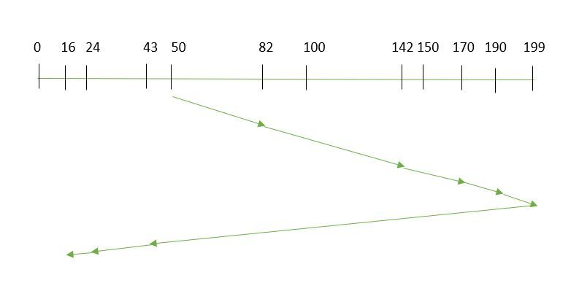
Disk Scheduling Algorithms

Slide 26
Disk Scheduling Algorithms
Advantages of SCAN Algorithm
High throughput
Low variance of response time
Average response time
Disadvantages of SCAN Algorithm
Long waiting time for requests for locations just visited by disk arm

Slide 27
Disk Scheduling Algorithms
C-SCAN
In the SCAN algorithm, the disk arm again scans the path that has been scanned, after reversing its direction. So, it may be possible that too many requests are waiting at the other end or there may be zero or few requests pending at the scanned area.
These situations are avoided in the CSCAN algorithm in which the disk arm instead of reversing its direction goes to the other end of the disk and starts servicing the requests from there. So, the disk arm moves in a circular fashion and this algorithm is also similar to the SCAN algorithm hence it is known as C-SCAN (Circular SCAN).

Slide 28
Disk Scheduling Algorithms
C-SCAN
Suppose the requests to be addressed are-82,170,43,140,24,16,190. And the Read/Write arm is at 50, and it is also given that the disk arm should move “towards the larger value”.
So, the total overhead movement (total distance covered by the disk arm) is calculated as:
=(199-50) + (199-0) + (43-0) = 391

Slide 29
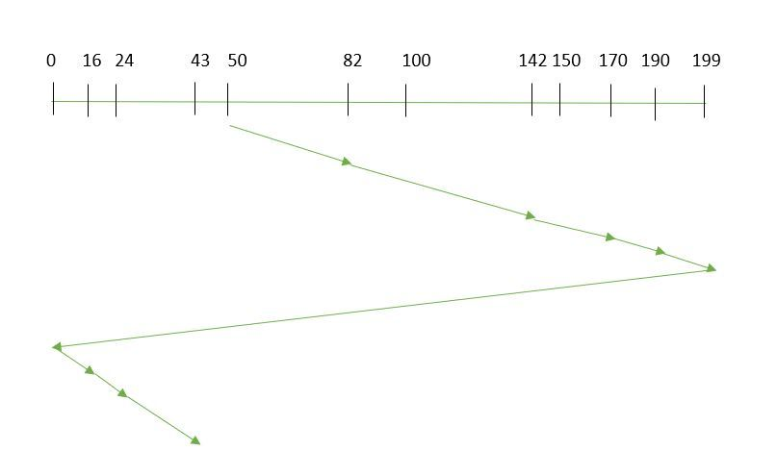
Disk Scheduling Algorithms
C-SCAN

Slide 30
Disk Scheduling Algorithms
Advantages of C-SCAN Algorithm
Provides more uniform wait time compared to SCAN.

Slide 31
Device controllers-DMA
DMA Controller is a hardware device that allows I/O devices to directly access memory with less participation of the processor.
DMA controller needs the same old circuits of an interface to communicate with the CPU and Input/Output devices.

Slide 32
Device controllers-DMA
What is DMA Controller?
Direct Memory Access uses hardware for accessing the memory, that hardware is called a DMA Controller.
It has the work of transferring the data between Input Output devices and main memory with very less interaction with the processor.
The direct Memory Access Controller is a control unit, which has the work of transferring data.

Slide 33
Device controllers-DMA
DMA Controller Diagram
DMA Controller is a type of control unit that works as an interface for the data bus and the I/O Devices.
As mentioned, DMA Controller has the work of transferring the data without the intervention of the processors, processors can control the data transfer.
DMA Controller also contains an address unit, which generates the address and selects an I/O device for the transfer of data. Here we are showing the block diagram of the DMA Controller.

Slide 34
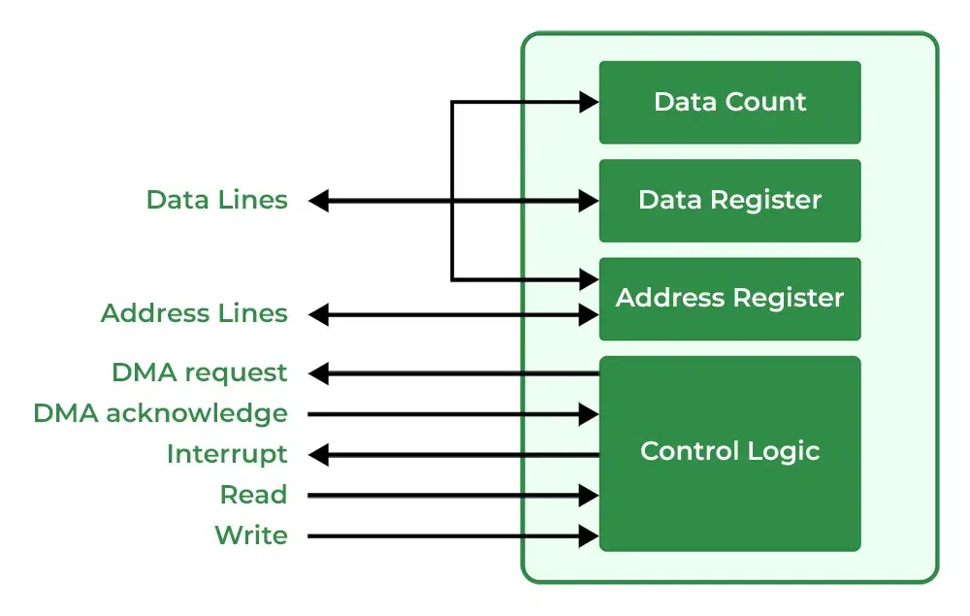
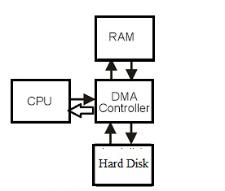
Device controllers-DMA
DMA Controller Diagram

Slide 35
Modes of I/O Data Transfer
Direct Memory Access
The data transfer between a fast storage media such as magnetic disk and memory unit is limited by the speed of the CPU.
Thus we can allow the peripherals directly communicate with each other using the memory buses, removing the intervention of the CPU.
This type of data transfer technique is known as DMA or direct memory access.
During DMA the CPU is idle and it has no control over the memory buses. The DMA controller takes over the buses to manage the transfer directly between the I/O devices and the memory unit.
Removing the CPU from the path and letting the peripheral device manage the memory buses directly would improve the speed of transfer. This technique is known as DMA.

Slide 36
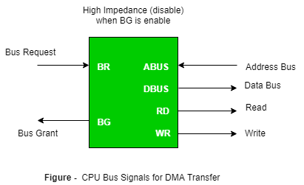
Modes of I/O Data Transfer
Direct Memory Access
Bus Request : It is used by the DMA controller to request the CPU to relinquish the control of the buses.
Bus Grant : It is activated by the CPU to Inform the external DMA controller that the buses are in high impedance state and the requesting DMA can take control of the buses. Once the DMA has taken the control of the buses it transfers the data. This transfer can take place in many ways.

Slide 37
Modes of I/O Data Transfer
Types of DMA transfer using DMA controller:
1. Burst Transfer :
DMA returns the bus after complete data transfer.
A register is used as a byte count, being decremented for each byte transfer, and upon the byte count reaching zero, the DMAC will release the bus.
When the DMAC operates in burst mode, the CPU is halted for the duration of the data transfer.
2. Cycle Stealing :
An alternative method in which DMA controller transfers one word at a time after which it must return the control of the buses to the CPU.
The CPU delays its operation only for one memory cycle to allow the direct memory I/O transfer to “steal” one memory cycle.

Slide 38
Device controllers-DMA
3. Transparent Mode:
Transparent Mode in DMA does not require any bus in the transfer of the data as it works when the CPU is executing the transaction.

Slide 39
Device controllers-DMA
Advantages of DMA Controller
Data Memory Access speeds up memory operations and data transfer.
CPU is not involved while transferring data.
DMA requires very few clock cycles while transferring data.
DMA distributes workload very appropriately.
DMA helps the CPU in decreasing its load.
Disadvantages of DMA Controller
Direct Memory Access is a costly operation because of additional operations.
DMA Controller increases the overall cost of the system.

Slide 40
I/O buffering
A buffer is a memory area that stores data being transferred between two devices or between a device and an application.
The buffer is an area in the main memory used to store or hold the data temporarily.
In other words, buffer temporarily stores data transmitted from one place to another, either between two devices or an application. The act of storing data temporarily in the buffer is called buffering.

Slide 41
I/O buffering
Uses of I/O Buffering :
Buffering is done to deal effectively with a speed mismatch between the producer and consumer of the data stream.
A buffer is produced in main memory to heap up the bytes received from modem.
After receiving the data in the buffer, the data get transferred to disk from buffer in a single operation.
When the first buffer got filled, then it is requested to transfer the data to disk.
The modem then starts filling the additional incoming data in the second buffer while the data in the first buffer getting transferred to disk.

Slide 42
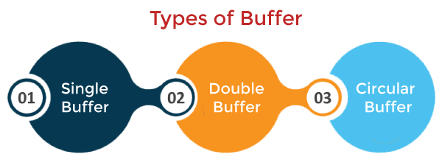
I/O buffering
Types of various I/O buffering techniques :
There are three main types of buffering in the operating system, such as:

Slide 43
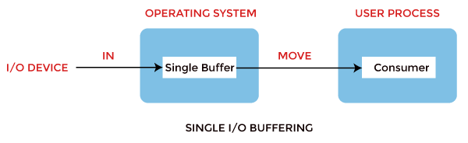
I/O buffering
1. Single Buffer
In Single Buffering, only one buffer is used to transfer the data between two devices. The producer produces one block of data into the buffer. After that, the consumer consumes the buffer. Only when the buffer is empty, the processor again produces the data.

Slide 44
I/O buffering
Block oriented device –
System buffer takes the input.
After taking the input, the block gets transferred to the user space by the process and then the process requests for another block.
Two blocks works simultaneously, when one block of data is processed by the user process, the next block is being read in.
OS can swap the processes.
OS can record the data of system buffer to user processes.

Slide 45
I/O buffering
Stream oriented device –
Line- at a time operation is used for scroll made terminals. User inputs one line at a time, with a carriage return signaling at the end of a line.
Byte-at a time operation is used on forms mode, terminals when each keystroke is significant.

Slide 46
I/O buffering
2. Double buffer :
Block oriented –
There are two buffers in the system.
One buffer is used by the driver or controller to store data while waiting for it to be taken by higher level of the hierarchy.
Other buffer is used to store data from the lower level module.
Double buffering is also known as buffer swapping.
A major disadvantage of double buffering is that the complexity of the process get increased.
If the process performs rapid bursts of I/O, then using double buffering may be deficient.

Slide 47
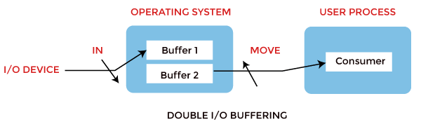
I/O buffering
2. Double buffer :
Stream oriented –
Line- at a time I/O, the user process need not be suspended for input or output, unless process runs ahead of the double buffer.
Byte- at a time operations, double buffer offers no advantage over a single buffer of twice the length.

Slide 48
I/O buffering
3. Circular Buffer
When more than two buffers are used, the buffers' collection is called a circular buffer. Each buffer is being one unit in the circular buffer. The data transfer rate will increase using the circular buffer rather than the double buffering.
In this, the data do not directly pass from the producer to the consumer because the data would change due to overwriting of buffers before consumed.
The producer can only fill up to buffer x-1 while data in buffer x is waiting to be consumed.

Slide 49
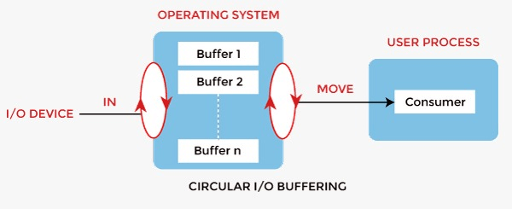
I/O buffering
3. Circular Buffer

Slide 50
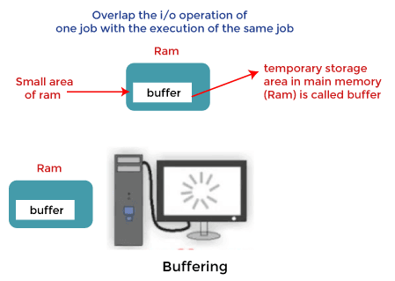
I/O buffering
How Buffering Works
In an operating system, buffer works in the following way:

Slide 51
I/O buffering
How Buffering Works
Buffering is done to deal effectively with a speed mismatch between the producer and consumer of the data stream.
A buffer is produced in the main memory to heap up the bytes received from the modem.
After receiving the data in the buffer, the data get transferred to a disk from the buffer in a single operation.
This process of data transfer is not instantaneous. Therefore the modem needs another buffer to store additional incoming data.
When the first buffer got filled, then it is requested to transfer the data to disk.

